Slide 1

Welcome to the
SE and CS Basics
The session will start shortly…
Questions? Drop them in the chat. We'll have dedicated moderators answering questions.

Slide 2

Cyber Security Session Housekeeping
The use of disrespectful language is prohibited in the questions, this is a supportive, learning environment for all - please engage accordingly. (Fundamental British Values: Mutual Respect and Tolerance)
No question is daft or silly - ask them!
There are Q&A sessions midway and at the end of the session, should you wish to ask any follow-up questions. Moderators are going to be answering questions as the session progresses as well.
If you have any questions outside of this lecture, or that are not answered during this lecture, please do submit these for upcoming Academic Sessions. You can submit these questions here: Questions

Slide 3
Cyber Security Session Housekeeping cont.
For all non-academic questions, please submit a query: www.hyperiondev.com/support
We would love your feedback on lectures: Feedback on Lectures
Find all the lecture content in you Lecture Backpack on GitHub.
If you are hearing impaired, please kindly enable captions on Google chrome/Microsoft Edge via the accessibility settings.

Slide 4

Stay Safe Series:
Mastering Online Safety One Week/step at a Time
While the digital world can be a wonderful place to make education and learning accessible to all, it is unfortunately also a space where harmful threats like online radicalisation, extremist propaganda, phishing scams, online blackmail and hackers can flourish.
As a component of this BootCamp the Stay Safe Series will/is designed to guide you through essential measures in order to protect yourself & your community from online dangers, whether they target your privacy, personal information or even attempt to manipulate your beliefs.
Stay Safe Series

Slide 5


Trustworthy Websites: How to Spot Secure Sites
Look for the padlock.
Check if there is a valid SSL/TLS certificate.
Look for a site seal.
Check if the URL is legitimate.
Pop-up and Redirection ads are a red flag.
Stay Safe Series

Slide 6


SE and CS Basics
December 2024
Notes:
Welcome to the Grammar Skills Bootcamp Orientation for November 2023. Today, we will cover several important aspects of this program to ensure you have all the information needed for a successful learning experience.

Slide 7


Learning Objectives & Outcomes
Use input/output function in Python.
Define basic Python data types such as string, int, float and boolean.
Create variables to reference back to values.
Perform operations of different data types.
Explain how code is used for cyber security.
Notes:
Mention moderators and Questions tab. Our agenda includes an introduction to CoGrammar, details about student success support, graduation criteria, guided learning hours, learning tools and platforms, an overview of the Skills Bootcamp, and career services.

Slide 8
CyberSecurity
Have you ever written a program? If so which language did you use?
Notes:
Mention moderators and Questions tab. Our agenda includes an introduction to CoGrammar, details about student success support, graduation criteria, guided learning hours, learning tools and platforms, an overview of the Skills Bootcamp, and career services.

Slide 9
CyberSecurity
What types of programs would you like to be able to create one day?
Notes:
Mention moderators and Questions tab. Our agenda includes an introduction to CoGrammar, details about student success support, graduation criteria, guided learning hours, learning tools and platforms, an overview of the Skills Bootcamp, and career services.

Slide 10
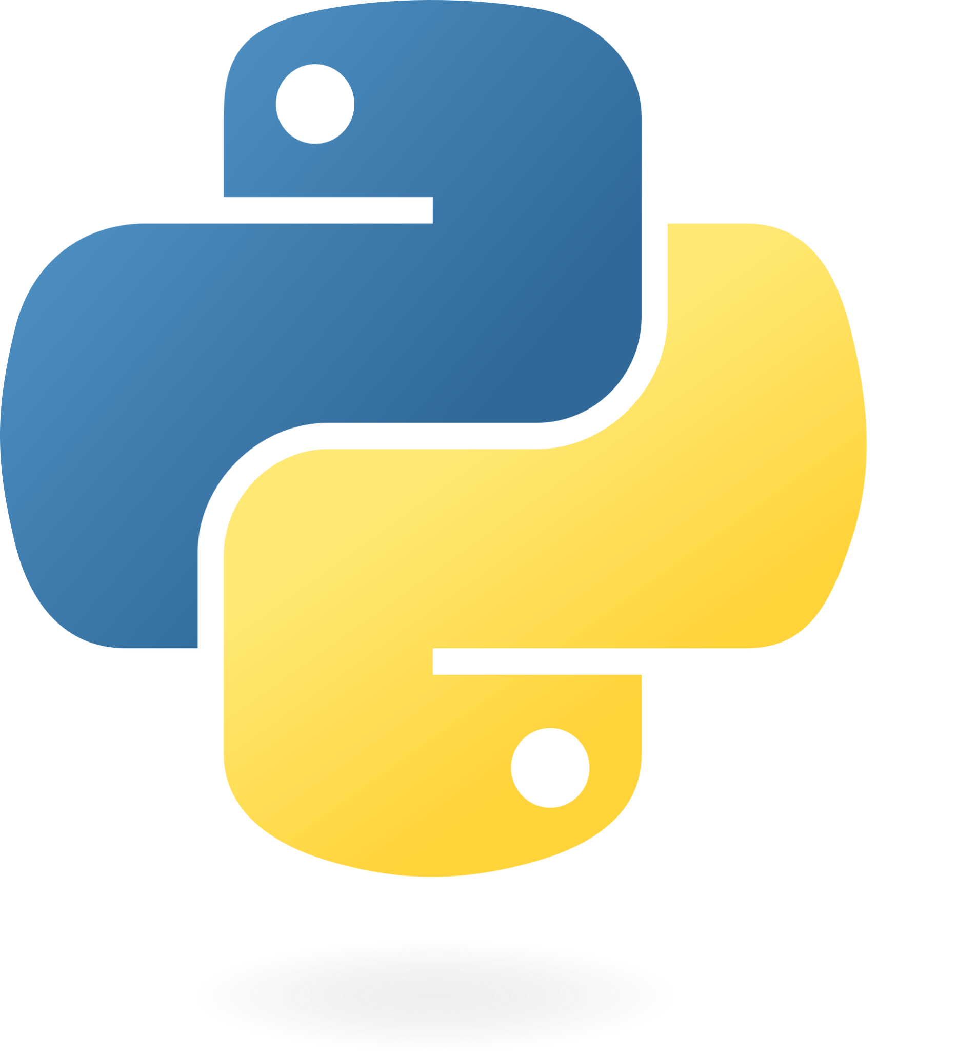
Python
Powerful and versatile programming language
Highly regarded in the field of software engineering and data science.
Clean and readable syntax
Vast ecosystem of libraries and frameworks.
Wide range of applications
web applications, data analysis, scientific computing and automation.
Strong community support.
Notes:
Mention moderators and Questions tab. Our agenda includes an introduction to CoGrammar, details about student success support, graduation criteria, guided learning hours, learning tools and platforms, an overview of the Skills Bootcamp, and career services.

Slide 11

Output
Communicate with our users.
You get different types of output but we will focus on output to the terminal using python’s built in print() function.
Execute function by adding parentheses after function name
We can add all the values we would like to print to the terminal inside the parentheses.
Notes:
Mention moderators and Questions tab. Our agenda includes an introduction to CoGrammar, details about student success support, graduation criteria, guided learning hours, learning tools and platforms, an overview of the Skills Bootcamp, and career services.

Slide 12
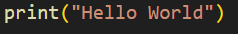
Output
Notes:
Mention moderators and Questions tab. Our agenda includes an introduction to CoGrammar, details about student success support, graduation criteria, guided learning hours, learning tools and platforms, an overview of the Skills Bootcamp, and career services.

Slide 13
Input
Input is how we receive data.
Different ways of getting input
hard coding input, terminal input using the built-in input() function and external files.
Using input() will allow us to receive input from the user through the terminal.
Similar to print we can add values to the input function to print to the terminal before listening for user input.
Notes:
Mention moderators and Questions tab. Our agenda includes an introduction to CoGrammar, details about student success support, graduation criteria, guided learning hours, learning tools and platforms, an overview of the Skills Bootcamp, and career services.

Slide 14
Input
Notes:
Mention moderators and Questions tab. Our agenda includes an introduction to CoGrammar, details about student success support, graduation criteria, guided learning hours, learning tools and platforms, an overview of the Skills Bootcamp, and career services.

Slide 15
Variables
Variables store data for later use.
Give a variable a name and provide it a value to reference back to.
E.g. my_variable = “Hello World”
The variable my_variable now references back to the value “Hello World”
Notes:
Mention moderators and Questions tab. Our agenda includes an introduction to CoGrammar, details about student success support, graduation criteria, guided learning hours, learning tools and platforms, an overview of the Skills Bootcamp, and career services.

Slide 16
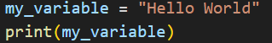
Variables
Notes:
Mention moderators and Questions tab. Our agenda includes an introduction to CoGrammar, details about student success support, graduation criteria, guided learning hours, learning tools and platforms, an overview of the Skills Bootcamp, and career services.

Slide 17
Variables Types
There are a bunch of data types in Python.
Common types
strings, integers, floats and booleans.
Strings are a sequence of characters that we usually use to represent text.
Integers and floats are numerical values and can be used to perform mathematical operations.
Booleans are a binary data type that can be only True or False.
Notes:
Mention moderators and Questions tab. Our agenda includes an introduction to CoGrammar, details about student success support, graduation criteria, guided learning hours, learning tools and platforms, an overview of the Skills Bootcamp, and career services.

Slide 18
Summary
We can receive input from the user though the terminal by using the input() function. We can also produce output to the terminal using print().
We can store values in variables to reference back to them for later use.
Basic data types we used are strings, integers, floats and booleans.
We implement code in different ways to add security to our programs such as hashing passwords.
Notes:
Drive the class around the activity
Ref: CSE 403: Software Engineering, Spring 2015
courses.cs.washington.edu/courses/cse403/15sp/
UML Sequence Diagrams

Slide 19
Questions and
Answers

Slide 20

Thank you for attending

Slide 21
Let’s take a short break

